Slide 1

Team 9 - Alzheimer’s Therapy
Bailey Brake, Ruohui Huang, Emily Lampat, Khang Le,
Yuri Zhang
Notes:
Bailey

Slide 2

Introduction - AlzLife
Client: Dr. Andrey Vyshedskiy
AlzLife App
40 Hz frequency light therapy
Phone attachment
Notes:
Bailey

Slide 3
Separation of T0 and T9 Models
After meeting with our client last semester, his needs were different from our product. Instead of starting over, we decided to create 2 designs with different use cases.
T0: Client model
Wall outlet powered - - - - - - - - - -
Phone attaches to LED panel - - - - -
Simplified on/off function - - - - - - - -
T9: Class model
Phone powered
Portable LED strip on phone
Brightness adjustability
Notes:
Bailey

Slide 4
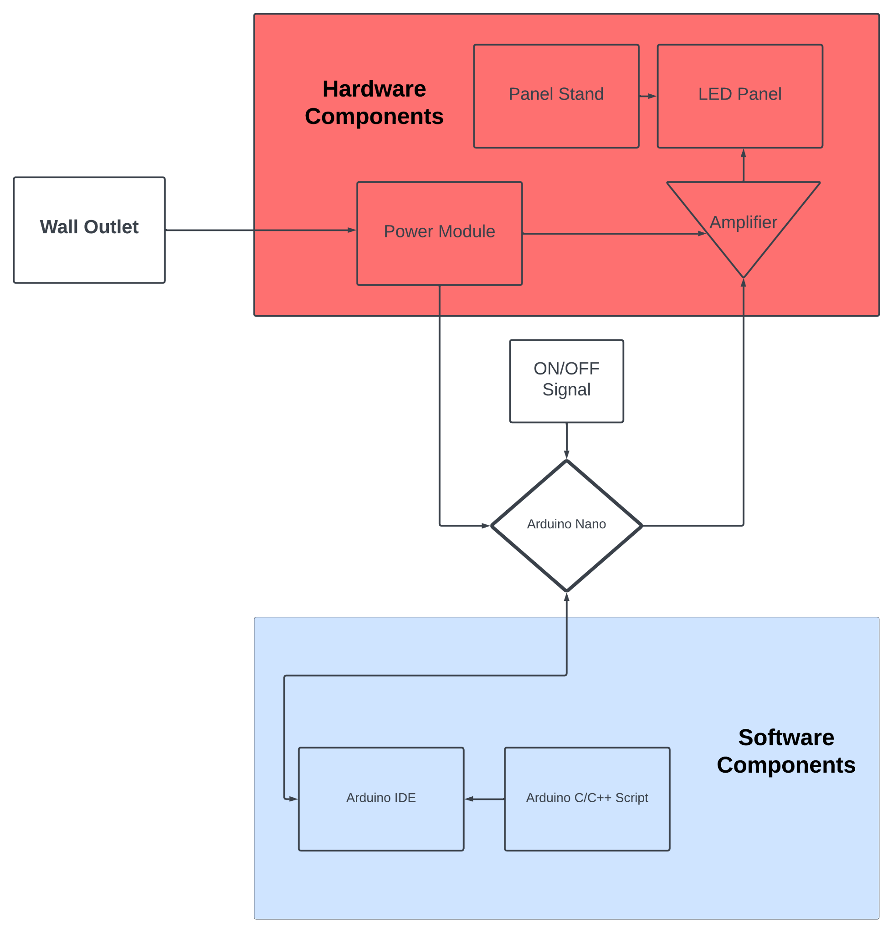
System Block Diagram (T0 Model)

Slide 5
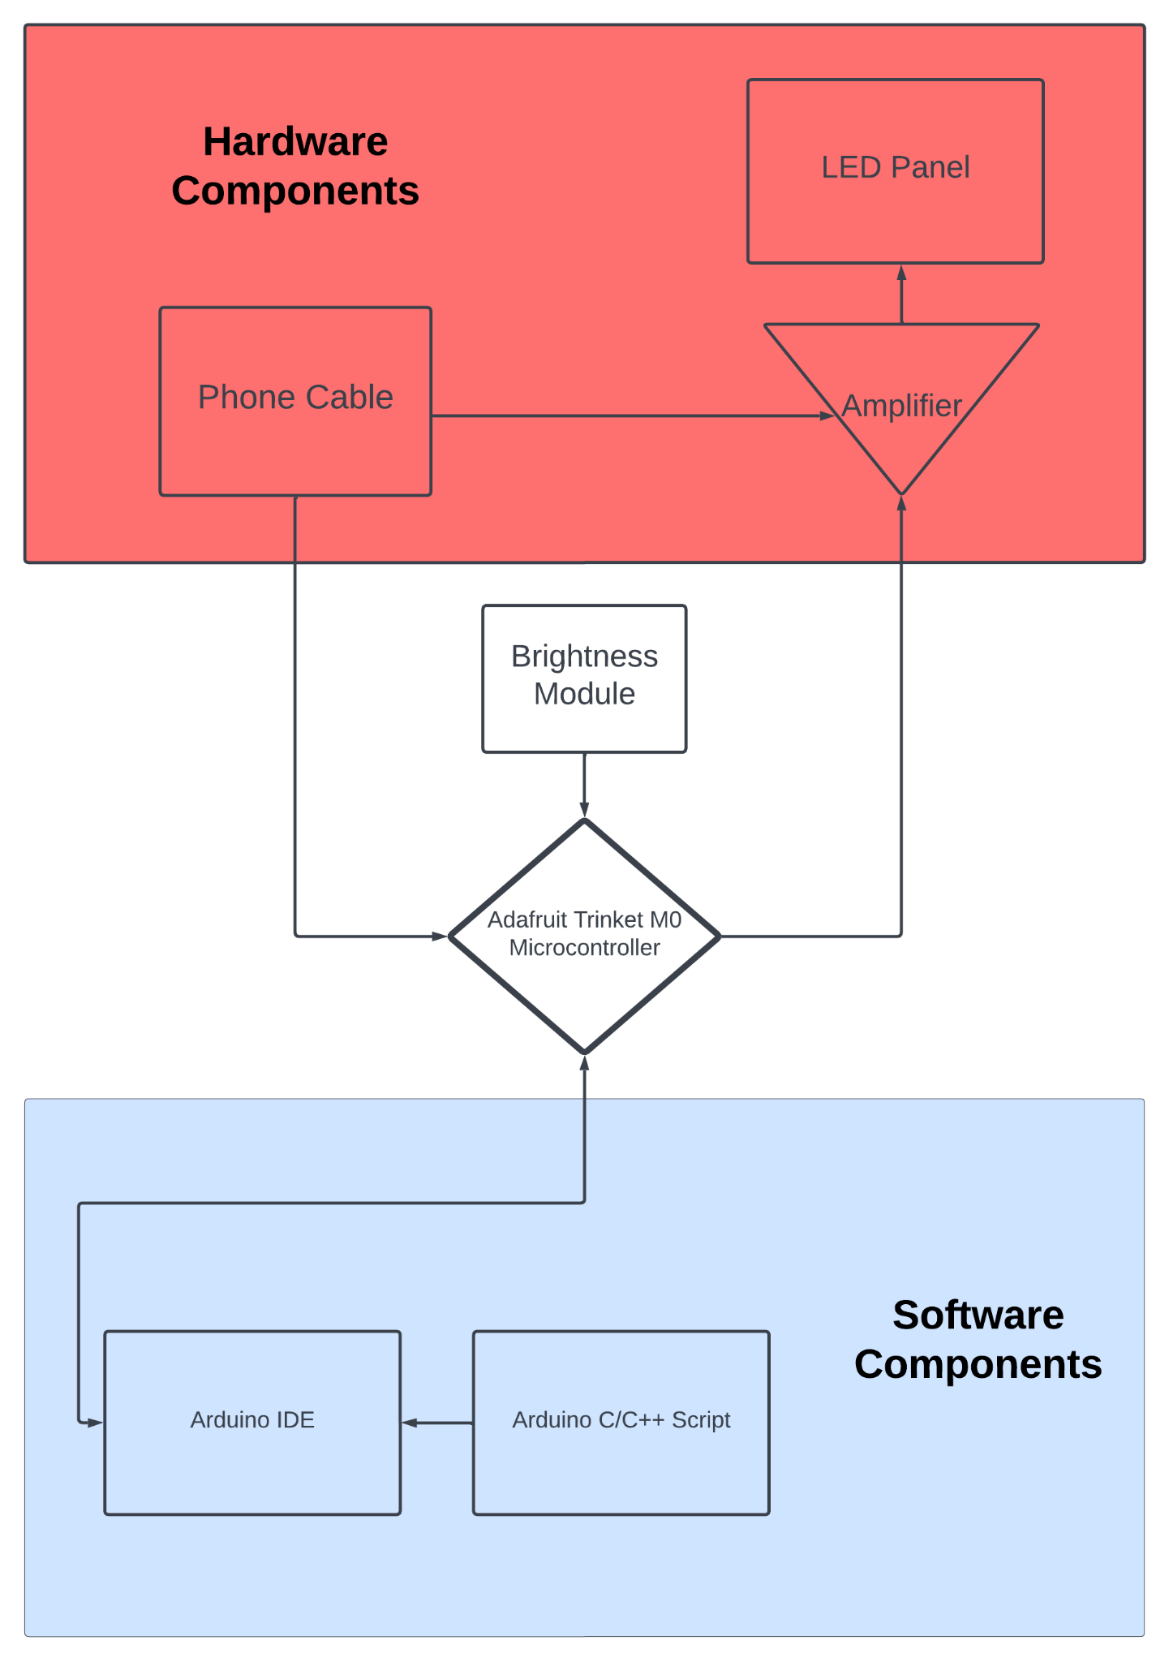
System Block Diagram (T9 Model)

Slide 6
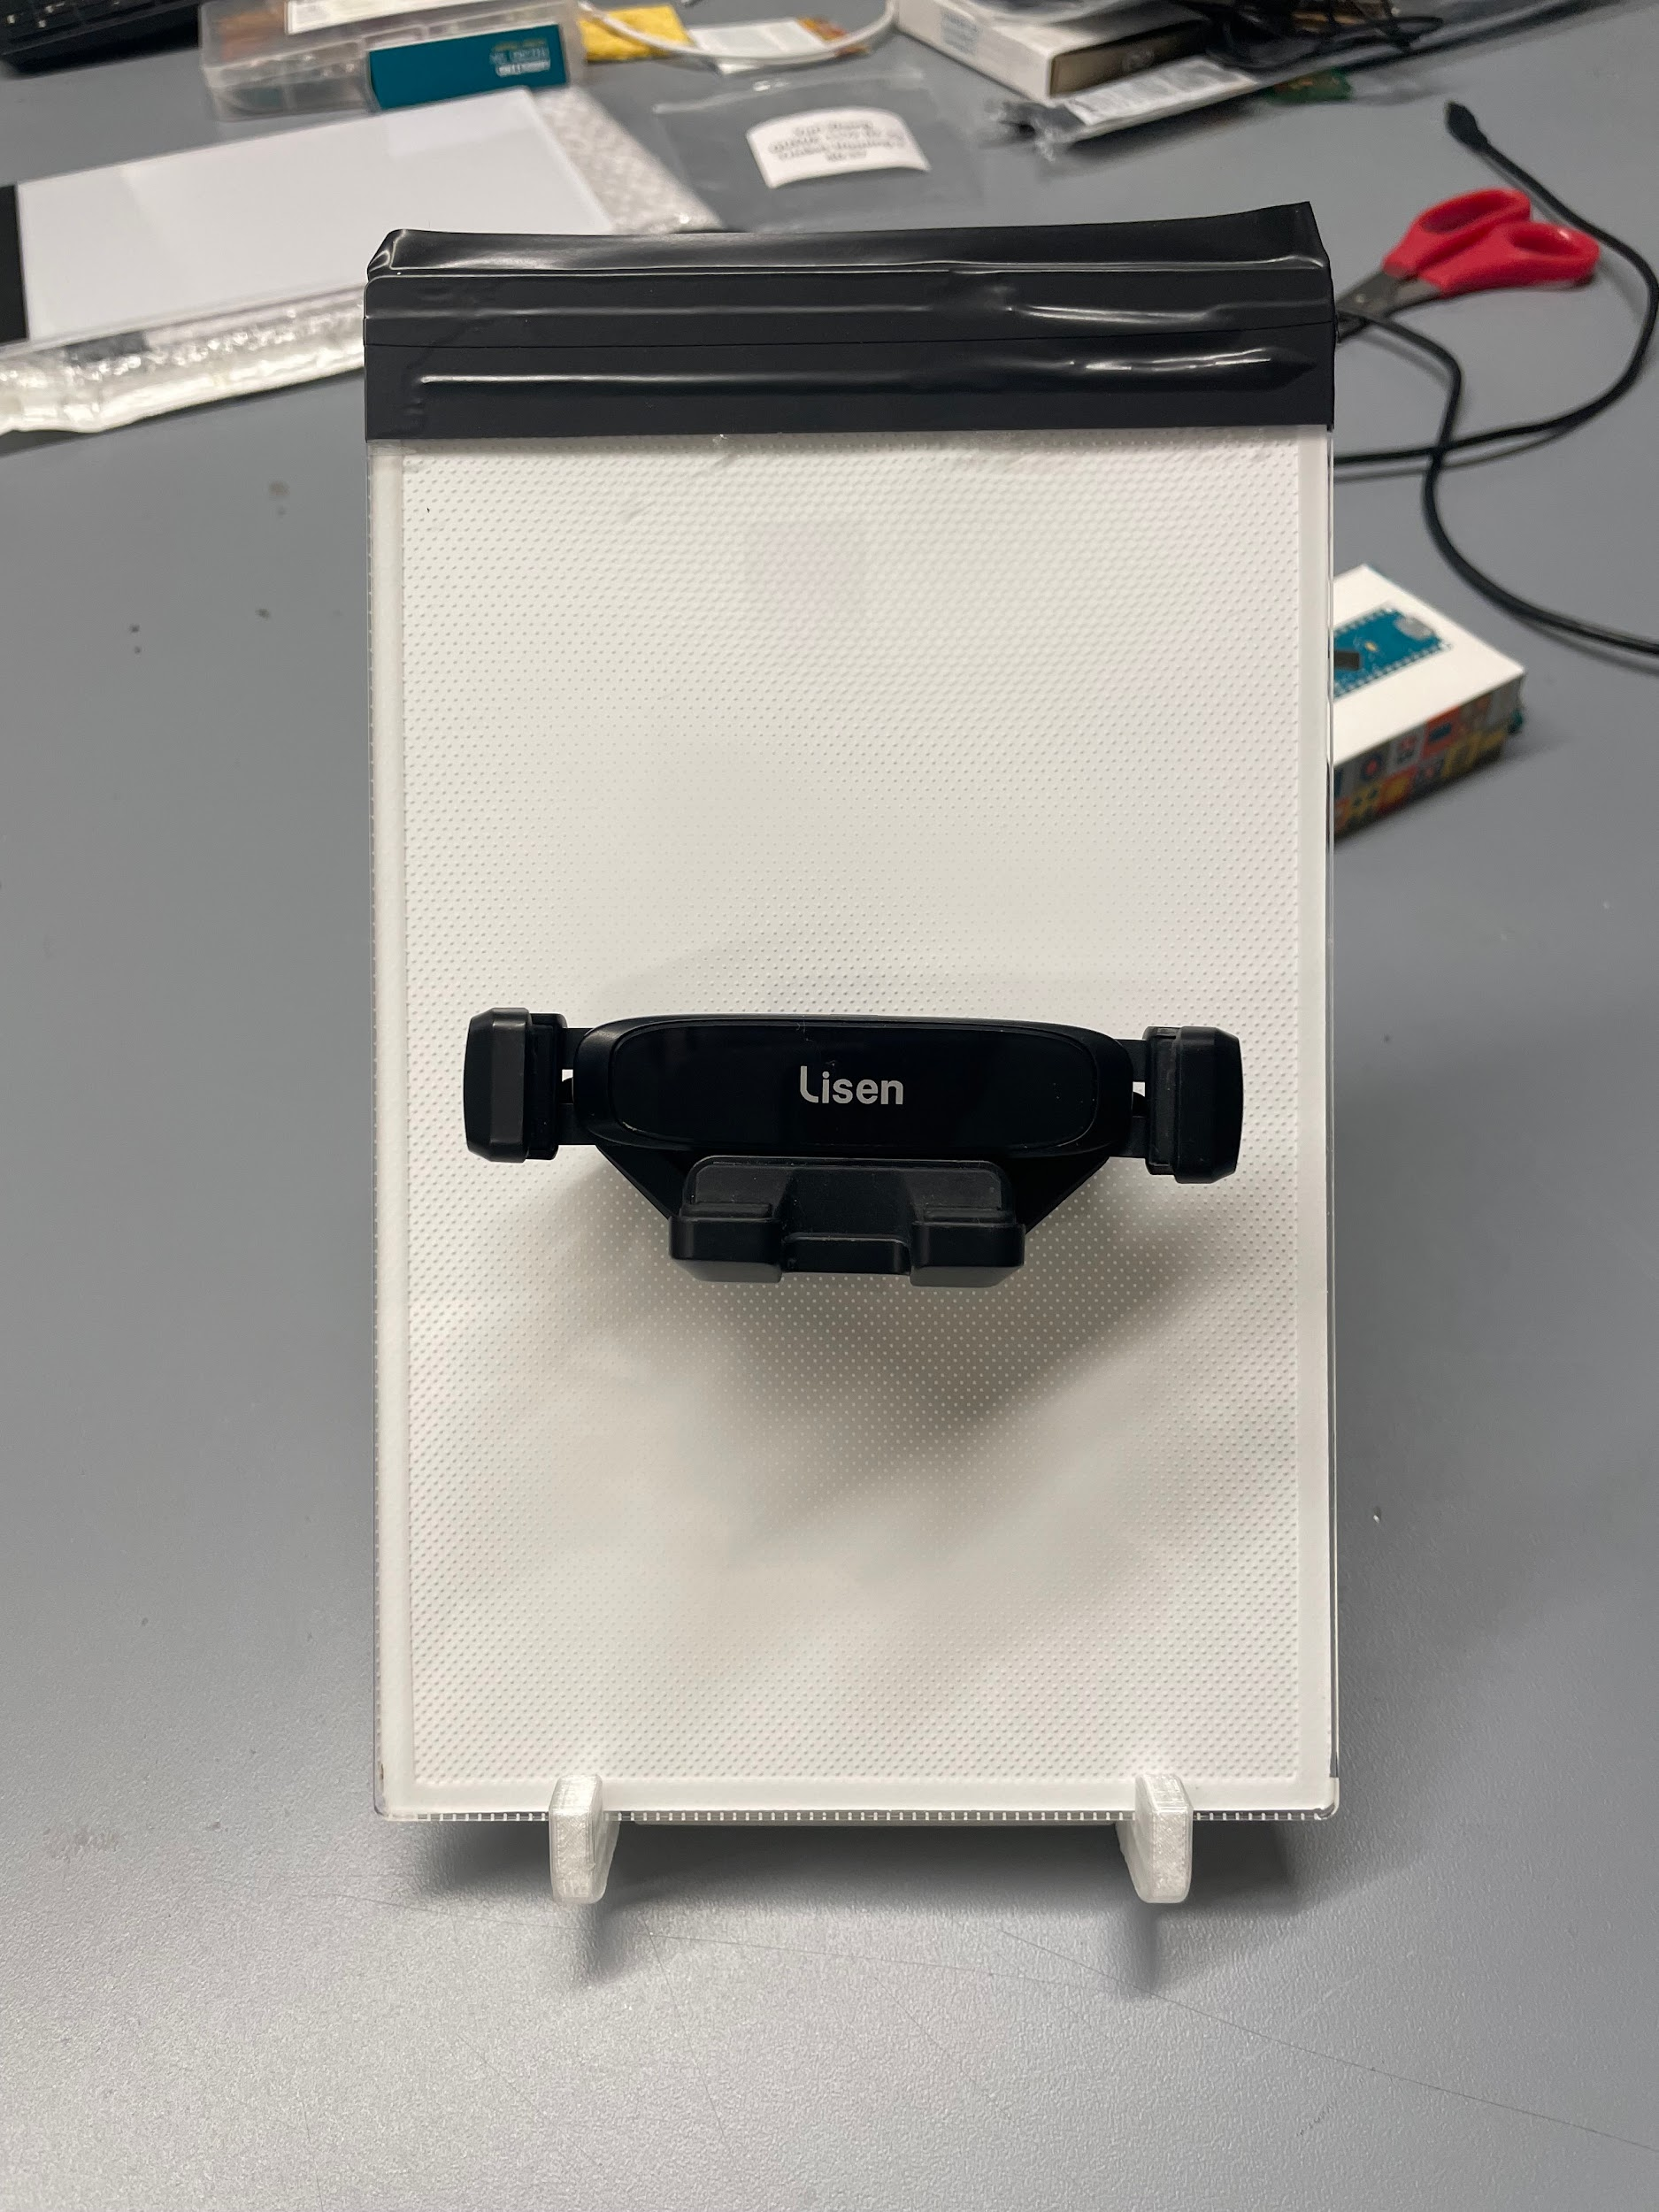
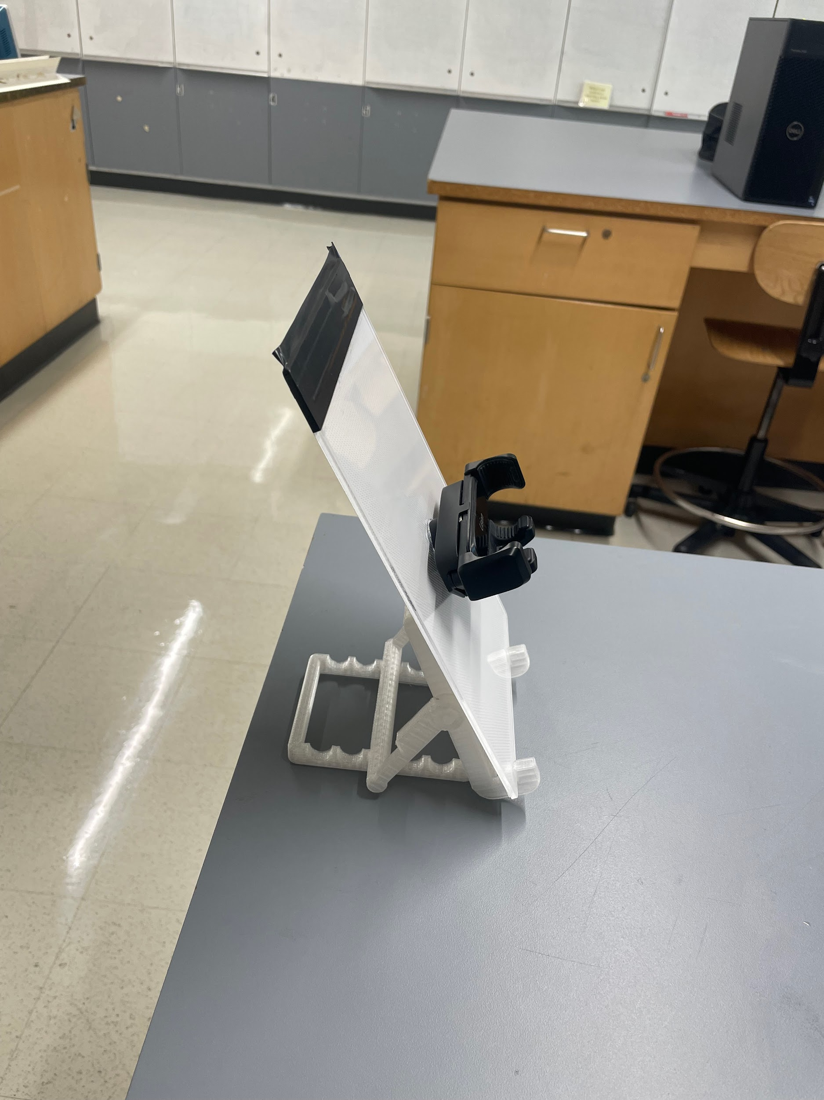
T0 Progress Completion
40 Hz Light Flickering
ON/OFF Button
Components soldered onto board
Phone holder on panel
Panel stand
Notes:
Khang

Slide 7
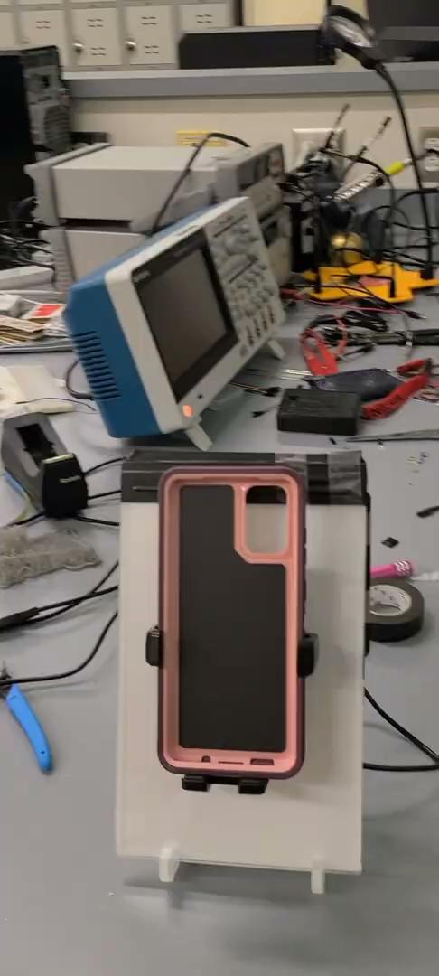
Notes:
Khang

Slide 8
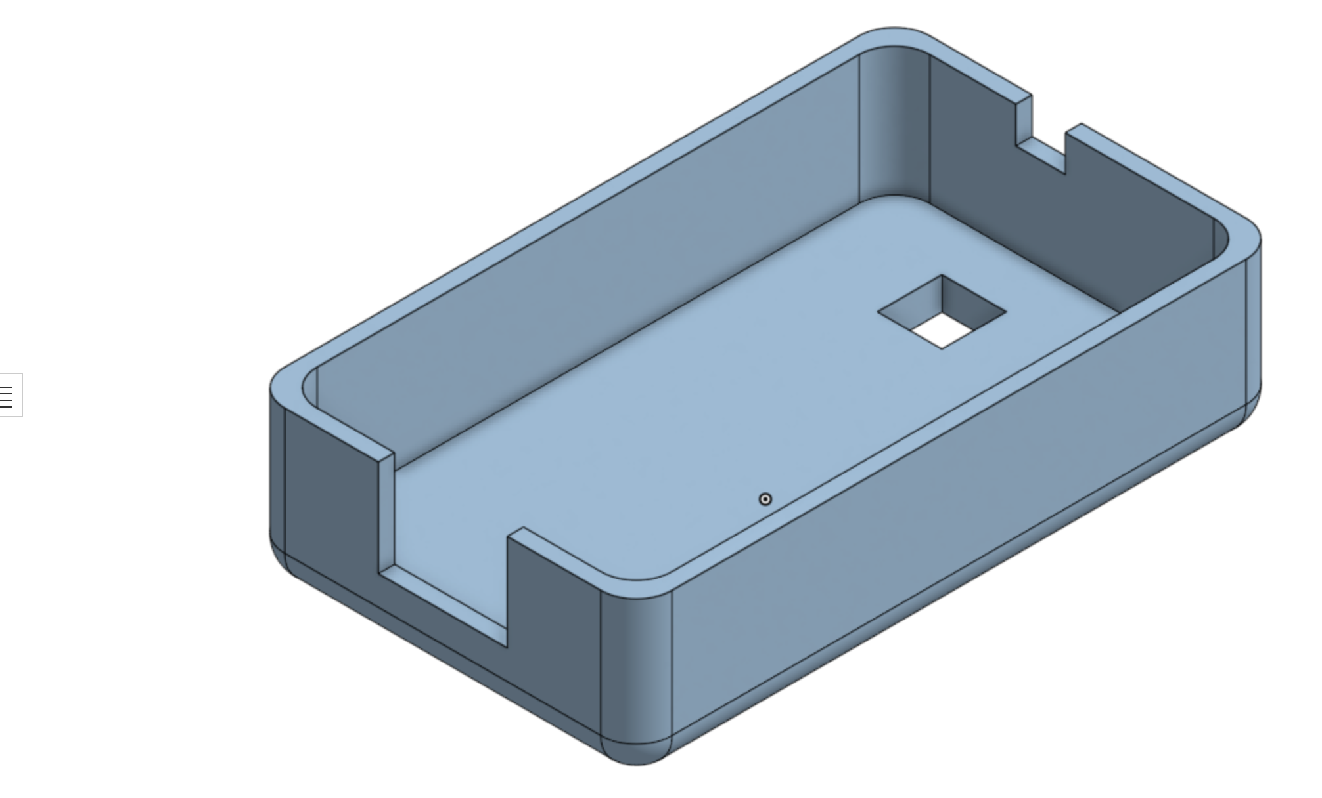
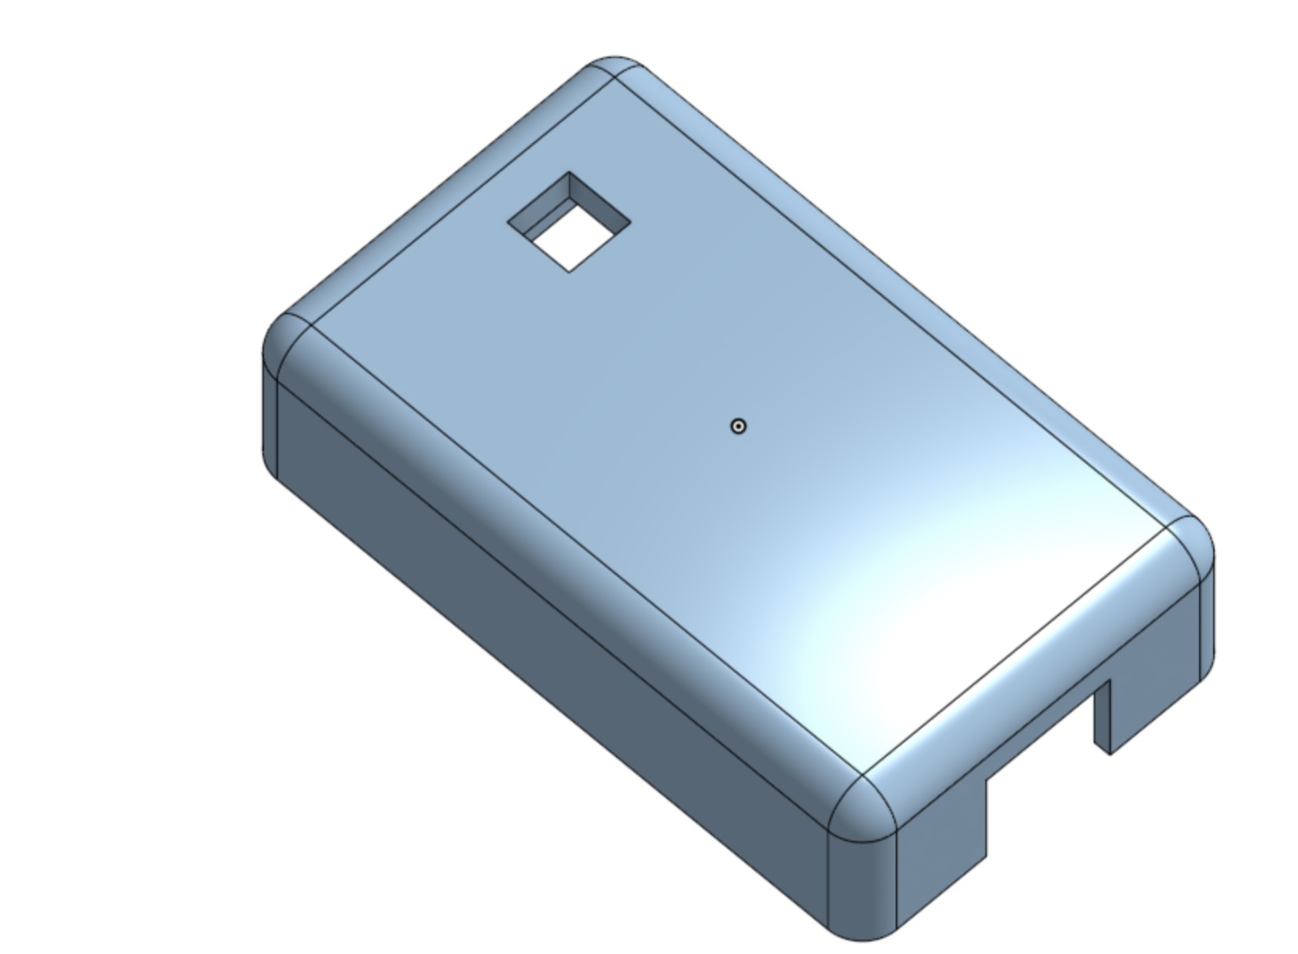
T0 Progress Completion (Housing)
Notes:
Emily

Slide 9
T9 Progress Completion
40Hz light flickering
Linear/static brightness adjustment
Stable connection on board with simplest possible circuit design
Compact/portable
Bright light with low voltage
Notes:
Yuri

Slide 10
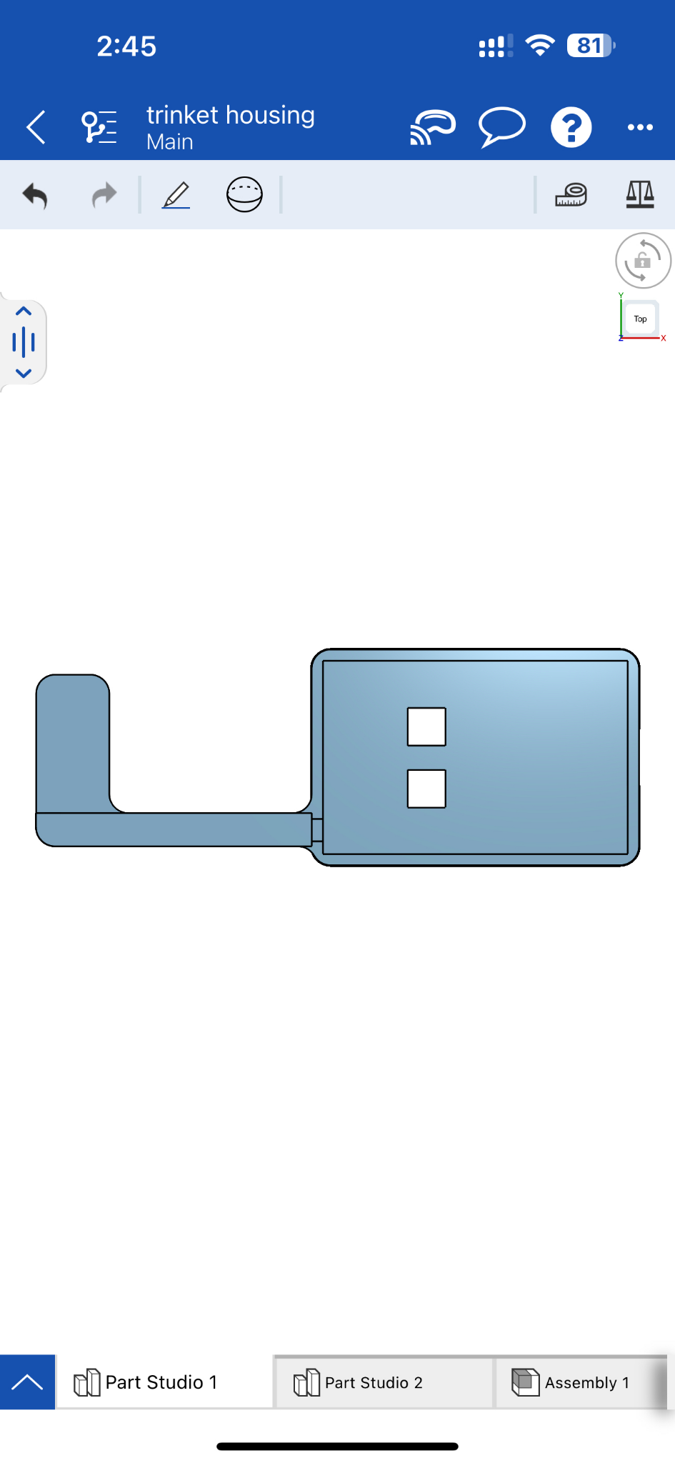
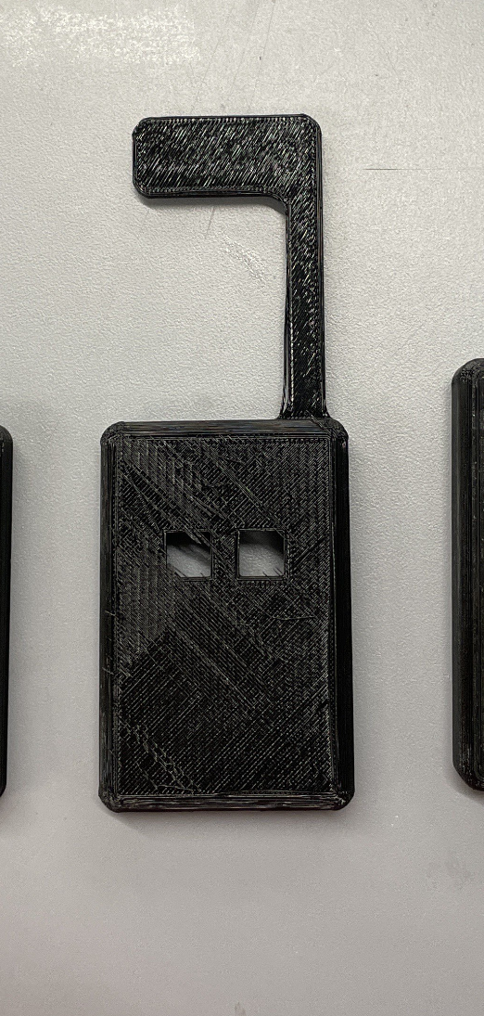
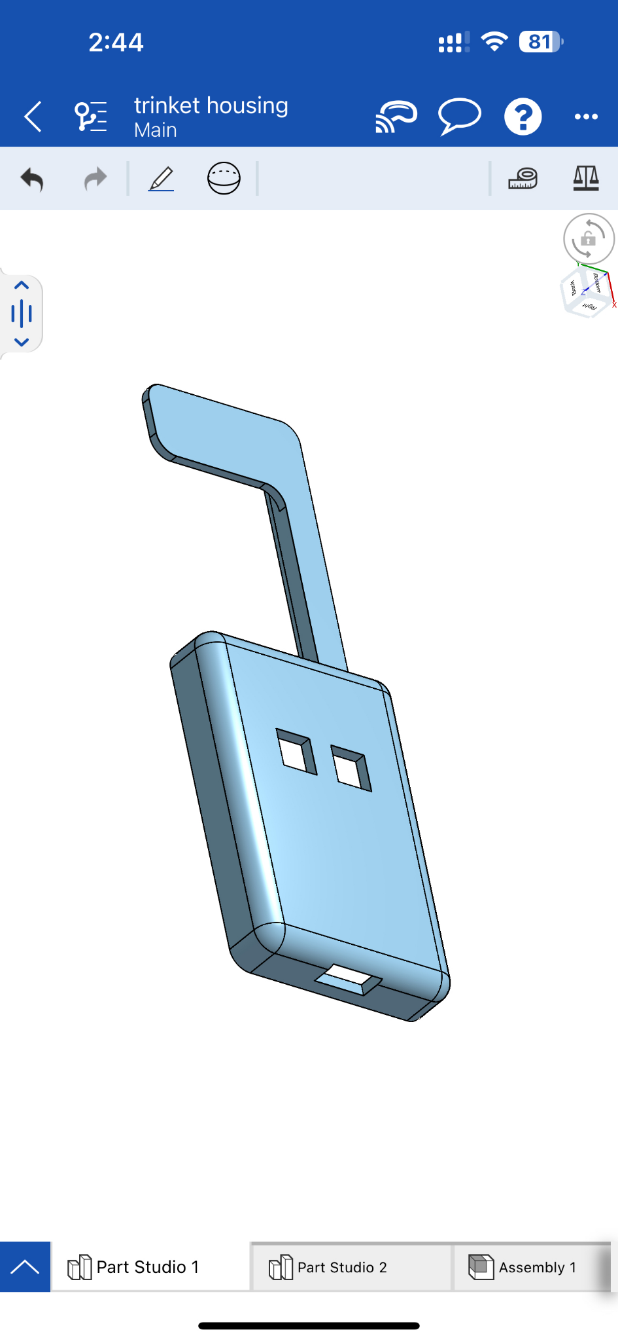
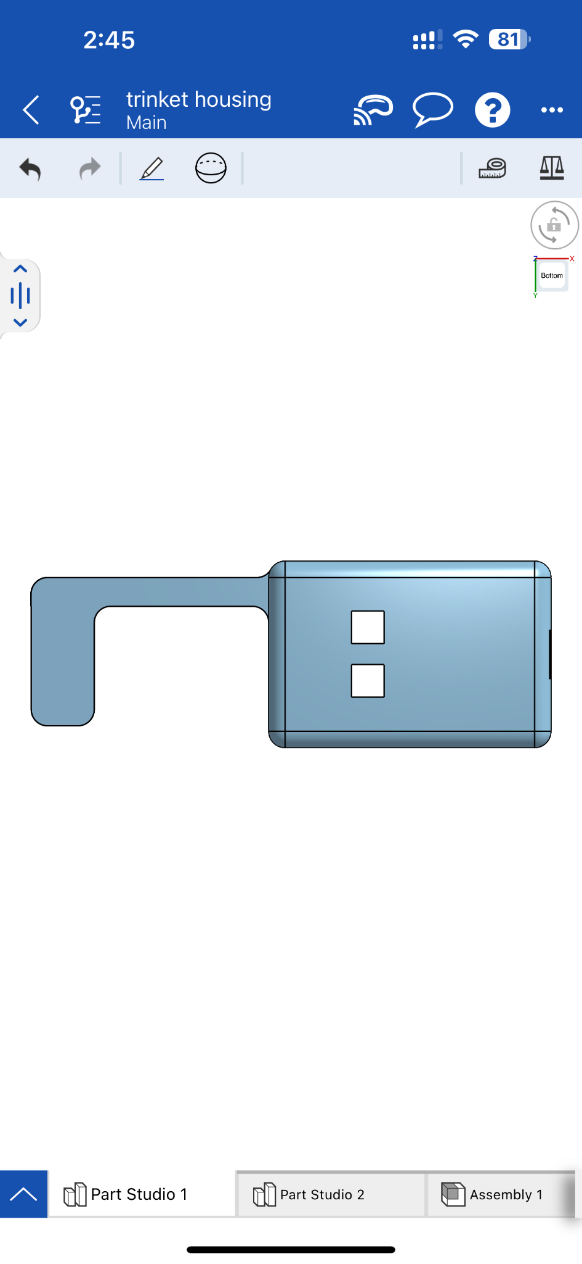
T9 Progress Completion (Housing)
Notes:
Yuri

Slide 11


Slide 12
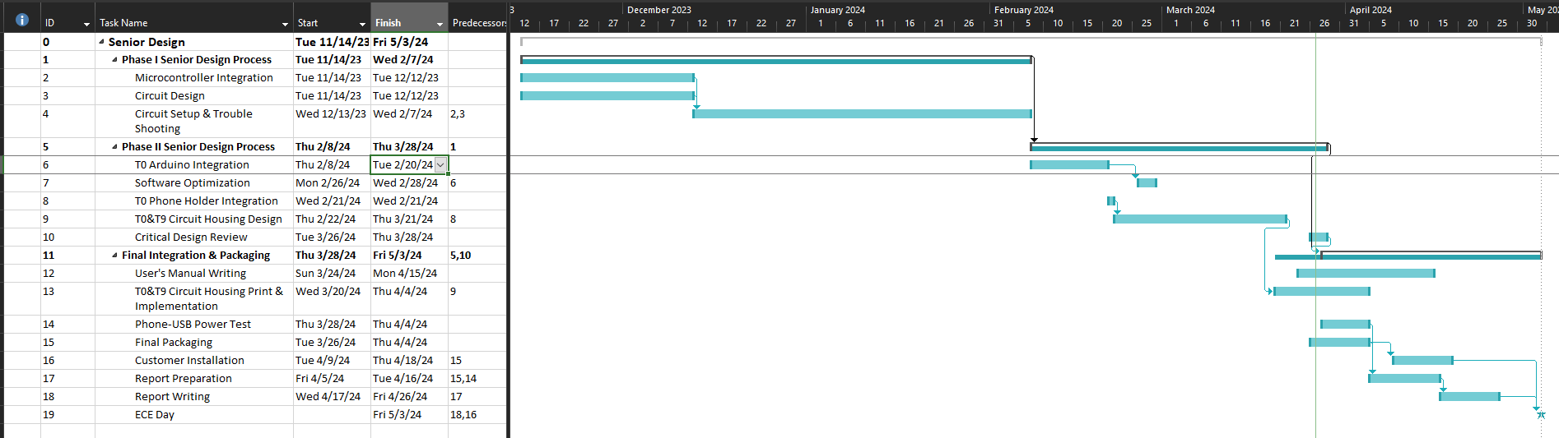
Gantt Chart
Notes:
Ruohui

Slide 13
What Still Needs To Be Done
T0 model:
Increase brightness of panel
Involves some rewiring to introduce amplifier
Electronics Housing
T9 model:
Electronics Housing
Notes:
T0 model: Introduced a mosfet to the circuit, currently trying to solidify connection
Housing fits and once we have the circuit set we will permanently attach it
T9 model: We have been running into issues with EPIC printing and are working towards finding a solution where the housing fits

Slide 14
Questions?

